Slide 1

Finland
By: Shubh, Gian-Carlo, Kabeer, Aleksi, Dariush
Here are some facts about Finland.

Slide 2
Basic facts
Total Population: 5.4 million.
Capital: Helsinki.
Life expectancy: Men 78 years, women 83 years.
Highest Mountain: Halti – 1,324 m above the sea.
Land area: 338,424 km.
Largest Lake: Suur-Saimaa (4400 km²)
National Day: 6 December (Independence Day).
Government: Republic, parliamentary democracy.

Slide 3
Interesting Facts
The latest UN report stated that Finland is now the happiest country in the world. The Nordic countries are in general always at the top, but Finland made a big climb this year from number 5 to number 1.
There are about 187,888 lake’s in Finland. The biggest lake is Saima lake, which is about 194km long.

Slide 4
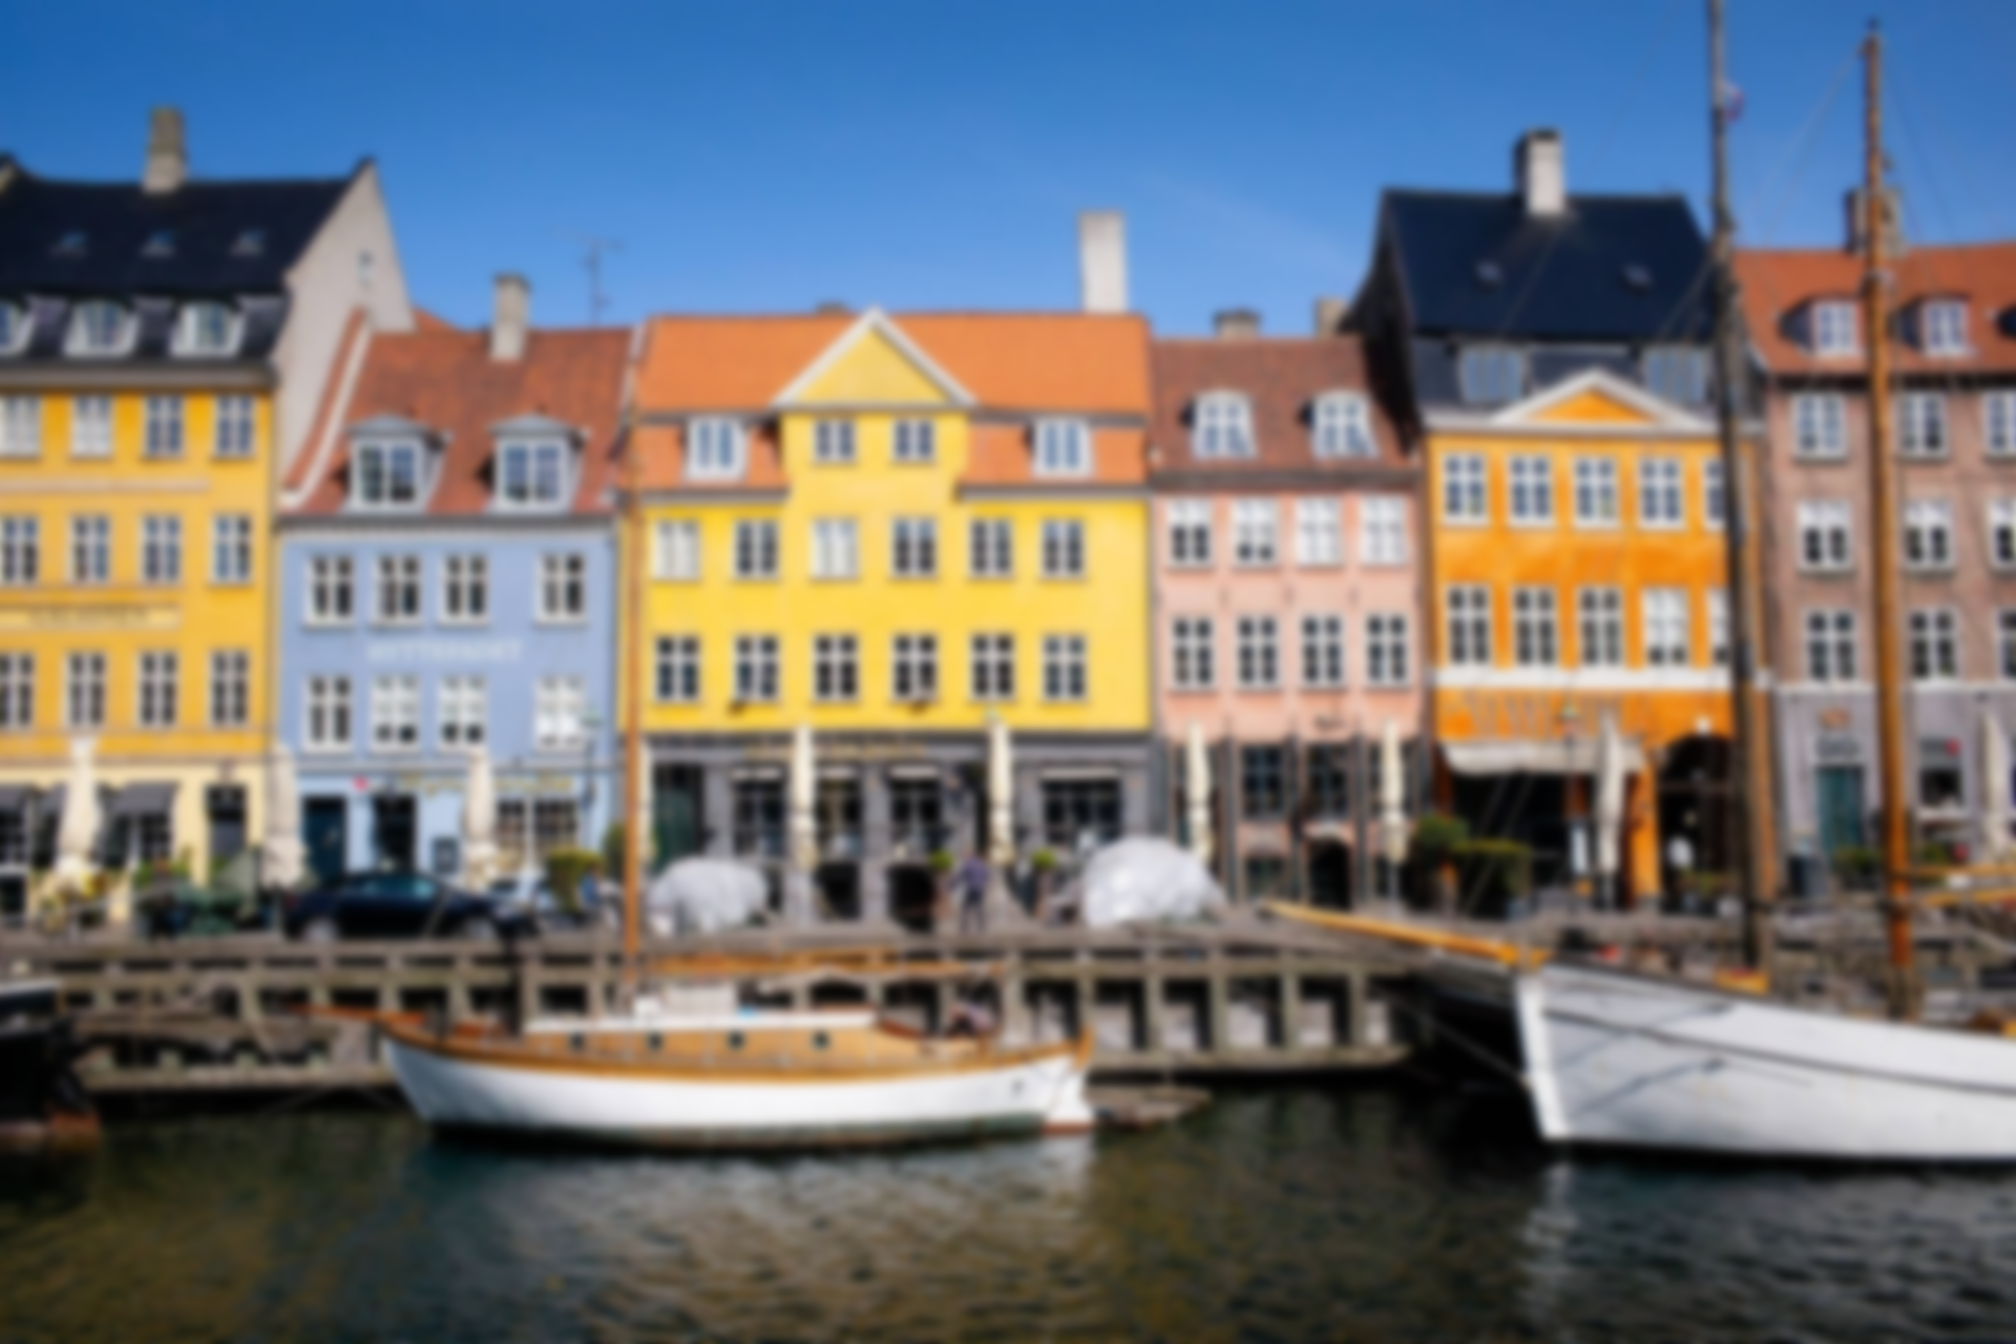
History of Finland
Until the middle of the 12th century, the geographical area that is now Finland was a political vacuum, though interesting to both its western neighbour Sweden and the Catholic Church there, and its eastern neighbour Novgorod (Russia) and its Greek Orthodox Church.
Sweden came out on top, as the peace treaty of 1323 between Sweden and Novgorod assigned only eastern Finland to Novgorod. The western and southern parts of Finland were tied to Sweden and the Western European cultural sphere, while eastern Finland, i.e. Karelia, became part of the Russo-Byzantine world.
Queen Margrethe II canThe Reformation set in motion a great rise in Finnish-language culture. The New Testament was translated into Finnish in 1548 by the Bishop of Turku, Mikael Agricola (1510–1557), who brought the Reformation to Finland and created written Finnish. The entire Bible appeared in Finnish in 1642.

Slide 5
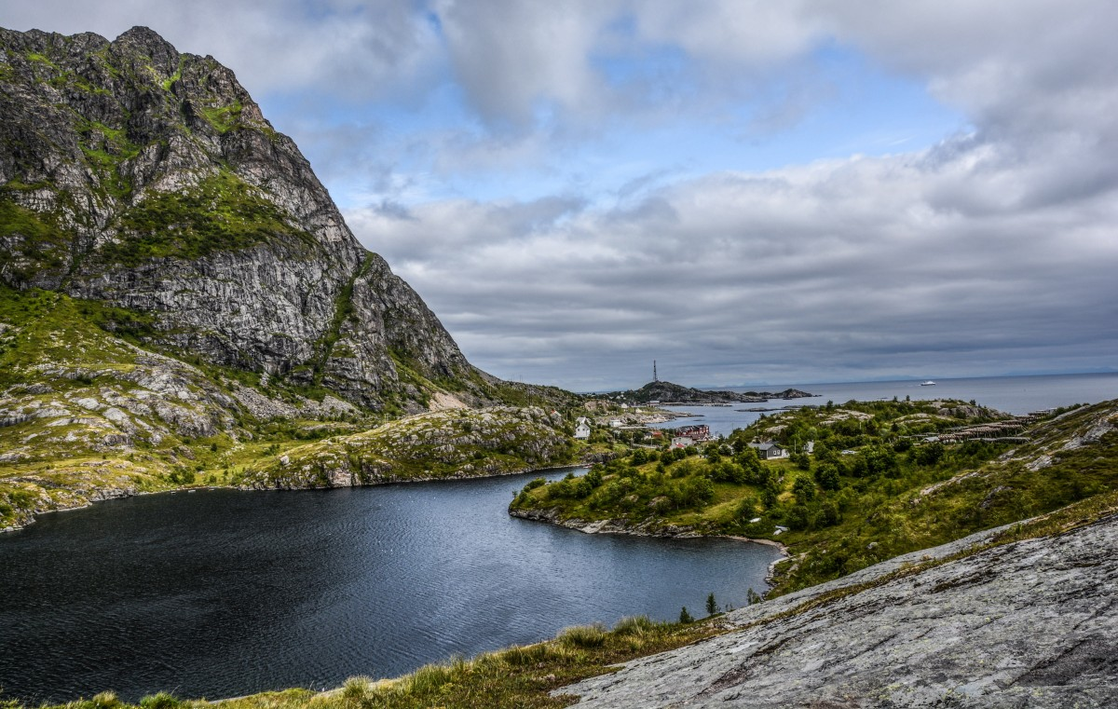
Not only has Finland been in the news recently, with its President visiting the US but the 2019 meeting of EAIE (European Association of International Educators) was also held last month in Helsinki, the country’s capital. We’ve decided to put the spotlight on Finland in this week’s blog post and share some fun facts about this Nordic country. We’ve also invited ACEI’s President and CEO, Jasmin Saidi-Kuehnert, who was in Helsinki for the EAIE conference to share her perspective.
Fun Facts

Slide 6
Link To My Site
https://verma-shubh-1704.github.io/Finland-Pro/

Slide 7
Thanks For Watching

